Slide 2
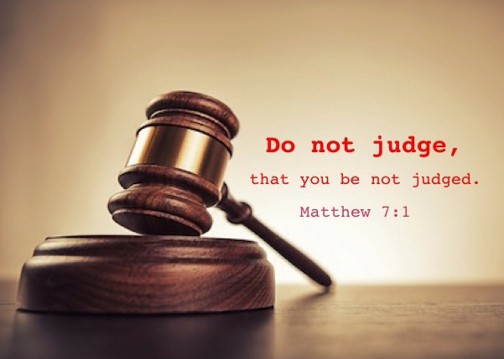
Sermon on the Mount
Matthew 5-7
“Fault Finding & Final Judgment”
Matthew 7:1-5

Slide 3
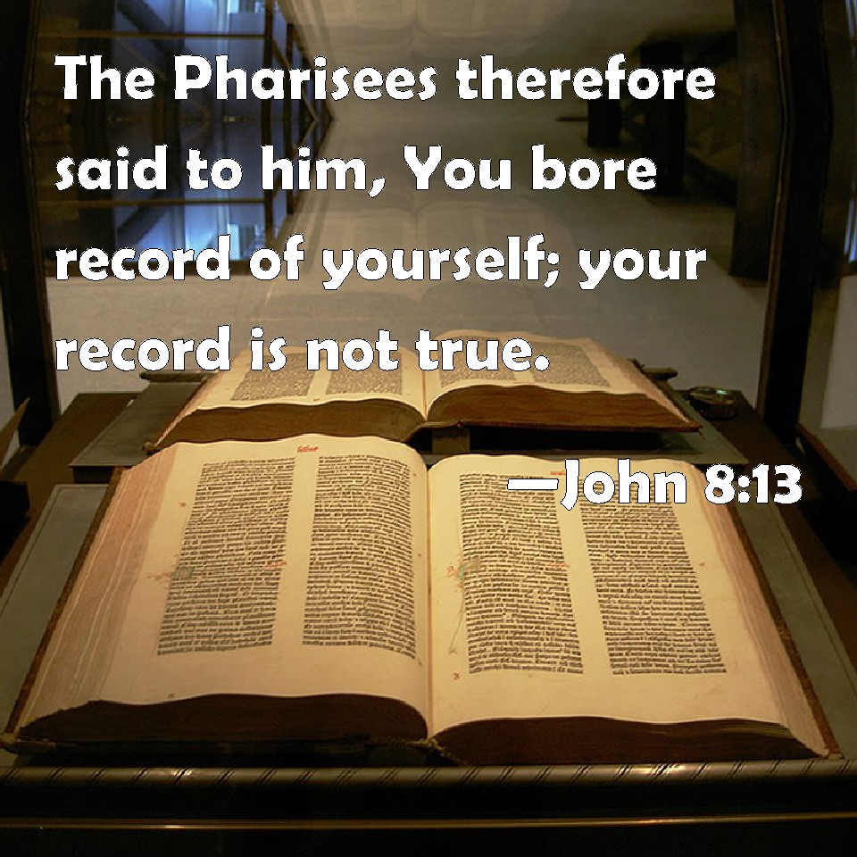
John 8:13-16 “…Jesus answered and said to them, “Even if I bear witness of Myself, My witness is true, for I know where I came from and where I am going; but you do not know where I come from and where I am going. "You judge according to the flesh; I judge no one. "And yet if I do judge, My judgment is true; for I am not alone, but I am with the Father who sent Me.”
John 8:5-7,10,11

Slide 4
CHRISTIAN’S CHARACTER MUST BE FREE FROM:
PRE-JUDGING
UNJUST CRITICISM
VENGEFUL CONDEMNATION

Slide 5
Sermon
on
the Mount
“JUDGE NOT…” (7:1)
Not a condemnation of all judgments
“judge not” V.1 & “then your will see clearly to remove the speck from your brother’s eye” V.5
Jesus deal with RIGHT and WRONG standards of judging

Slide 6
Sermon
on
the Mount
STANDARD IS THE LAW OF GOD
John 7:24 “Do not judge according to appearance, but judge with righteous judgment.”
Appearance- “the outward appearance, look… external appearance… of the outward aspect of a person.”
Righteous Judgment is what we must exercise every day- 1 John 4:6; Titus 1:9
1 Corinthians 6:2

Slide 7
Sermon
on
the Mount
FALSE ATTITUDES CONDEMNED IN JUDING
A Critical Spirit Of Fault Finding
Difference between pointing out doctrinal error and criticizing for the sake of criticizing
Condemnation Of Others Out Of A Mean of Hateful Spirit
Some people are just MEAN!
Condemnation Driven By Vengeance & Ill Motives
Trying to divert attention away from selves
“Final Judgment” as if We Have The Power To Justify or Condemn!

Slide 8
Sermon
on
the Mount
IMPERFECT JUDGMENT OF OTHERS WILL BRING OUR OWN CONDEMNATION
Matthew 7:2-5
Acts 23:3 “command me to be struck contrary to the law”
Intentional Discrimination Brings Evil
God will measure us by the same yardstick we use – unfair, cannot expect JUSTICE!
Matthew 7:3-5
Proper motives change a person

Slide 9
Sermon
on
the Mount
Some False Attitudes:
“Don’t tell another person they are WRONG at all!”
“Don’t tell another person they are WRONG about ANYTHING unless YOU are first PERFECT!”
“Since I can’t judge, I have to leave that sin with God, and perhaps He will excuse it. He is a righteous God.”
“DON’T GET INVOLVED IN CORRECTING ANY WRONG IN OTHERS!”

Slide 10
I Must Judge, But RIGHTEOUSLY
I Am NOT To
Judge UNRIGHTEOUSLY
FINAL JUDGMENT IS WITH GOD

